Slide 1

332:479 Concepts in VLSI
Design
Lecture 4
MUXes, Latches, Flip-Flops & Layout
David Harris and Michael Bushnell
Harvey Mudd College and Rutgers University
Spring 2004

Slide 2
Outline
CMOS Gate Design
Pass Transistors
CMOS Latches & Flip-Flops
Standard Cell Layouts
Stick Diagrams
Summary
Material from: CMOS VLSI Design,
by Weste and Harris, Addison-Wesley, 2005

Slide 3
CMOS Gate Design
Activity:
  Sketch a 4-input CMOS NAND gate

Slide 4
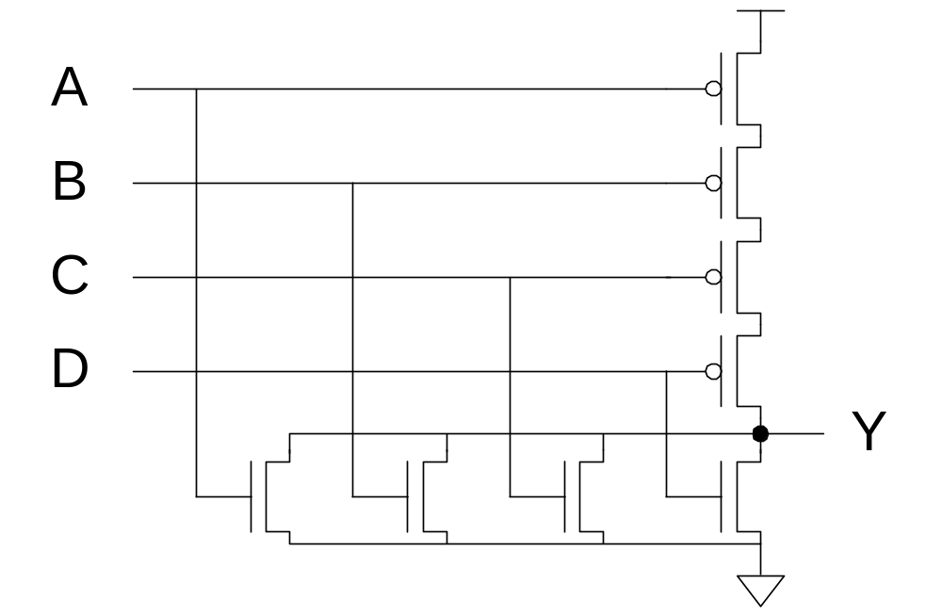
CMOS Gate Design
Activity:
  Sketch a 4-input CMOS NOR gate

Slide 5
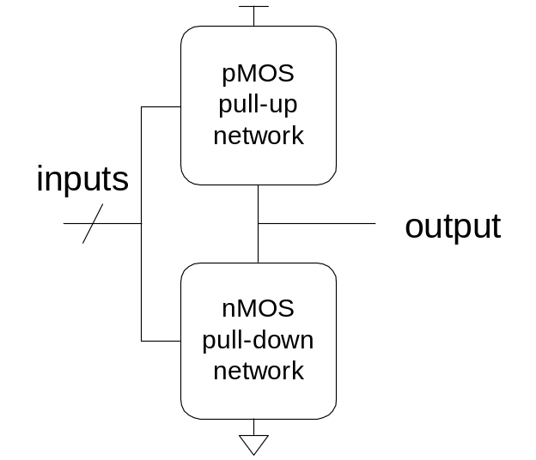
Complementary CMOS
Complementary CMOS logic gates
  nMOS pull-down network
  pMOS pull-up network
  a.k.a. static CMOS
 | Pull-up OFF | Pull-up ON
Pull-down OFF | Z (float) | 1
Pull-down ON | 0 | X (crowbar)

Slide 6
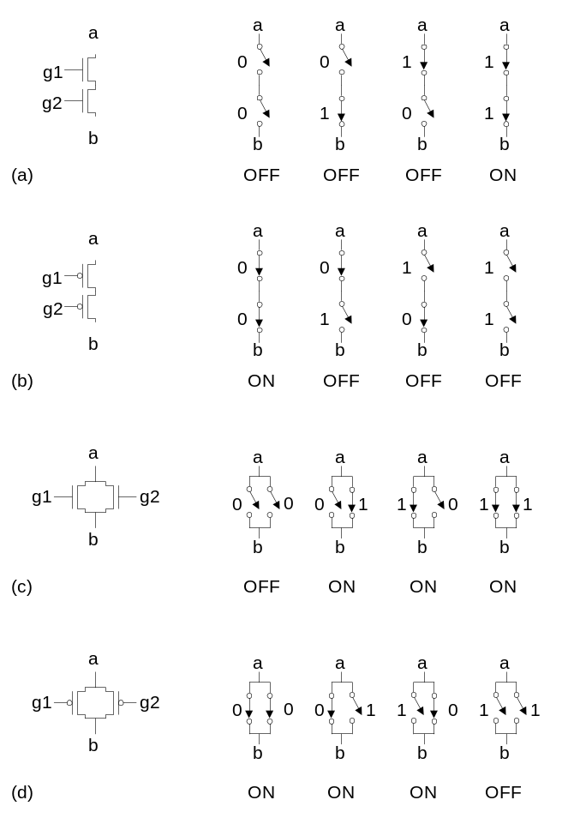
Series and Parallel
nMOS: 1 = ON
pMOS: 0 = ON
Series: both must be ON
Parallel: either can be ON

Slide 7
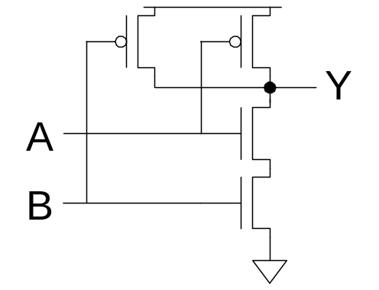
Conduction Complement
Complementary CMOS gates always produce 0 or 1
Ex: NAND gate
  Series nMOS: Y=0 when both inputs are 1
  Thus Y=1 when either input is 0
  Requires parallel pMOS
Rule of Conduction Complements
  Pull-up network is complement of pull-down
  Parallel -> series, series -> parallel

Slide 8
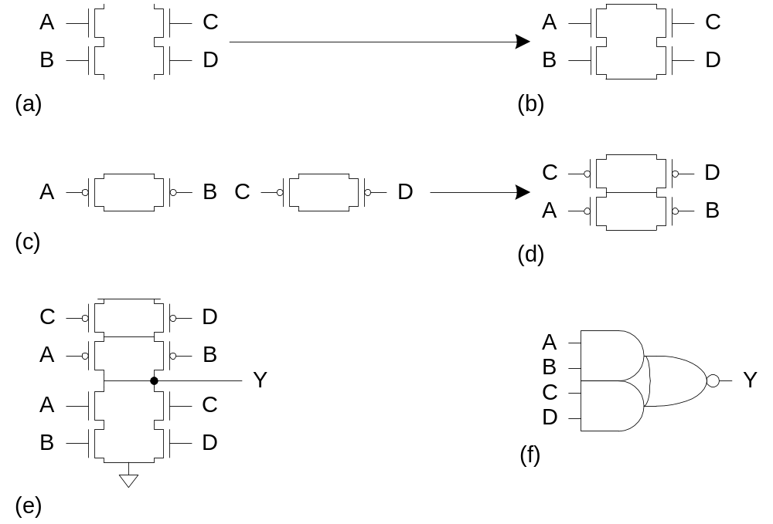
Compound Gates
Compound gates can do any inverting function
Ex:

Slide 9
Example: O3AI
Y = ( A + B + C) D

Slide 10
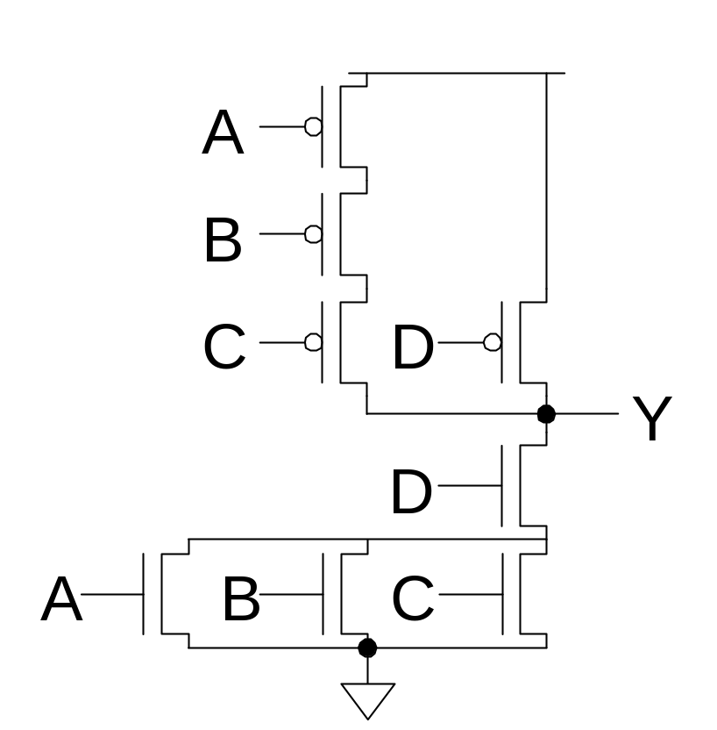
Example: O3AI
Y = ( A + B + C) D

Slide 11
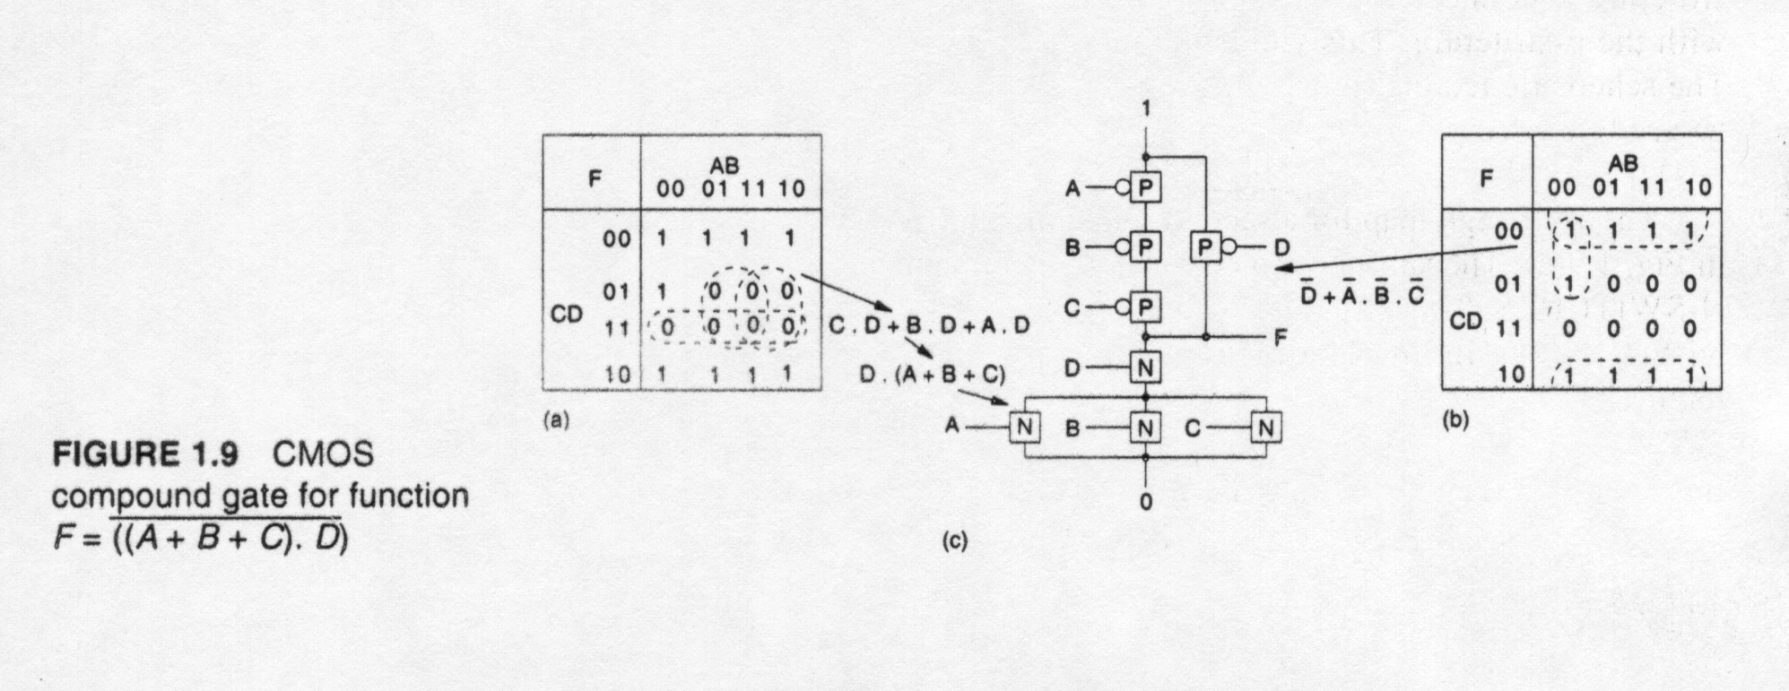
Compound Gate Truth Table
Compound CMOS logic gate function:

Slide 12
Signal Strength
Strength of signal
  How close it approximates ideal voltage source
V_{DD} and GND rails are strongest 1 and 0
nMOS pass strong 0
  But degraded or weak 1
pMOS pass strong 1
  But degraded or weak 0
Thus nMOS are best for pull-down network

Slide 13
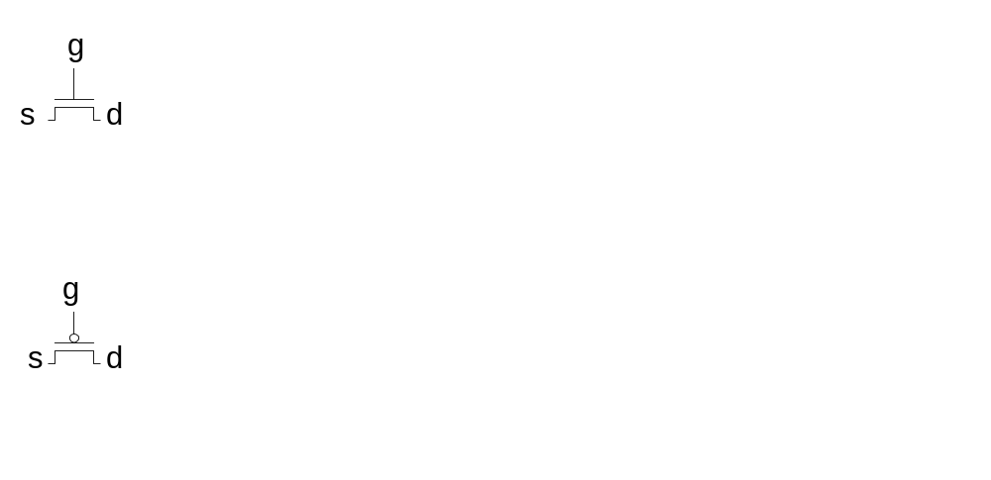
Pass Transistors
Transistors can be used as switches

Slide 14
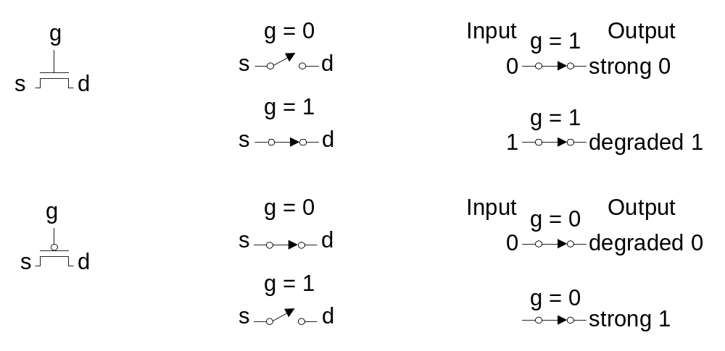
Pass Transistors
Transistors can be used as switches

Slide 15
Transmission Gates
Pass transistors produce degraded outputs
Transmission gates pass both 0 and 1 well

Slide 16
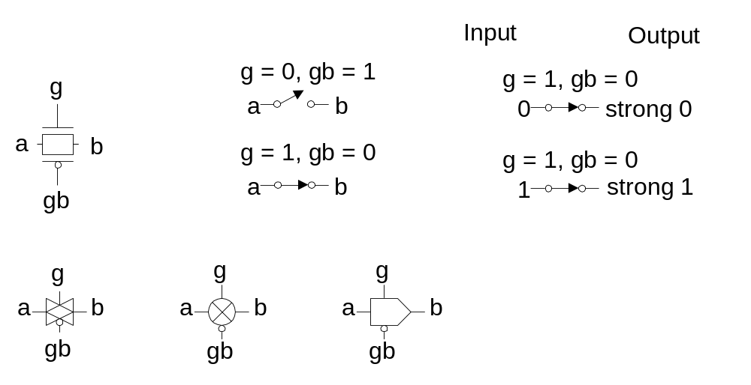
Transmission Gates
Pass transistors produce degraded outputs
Transmission gates pass both 0 and 1 well

Slide 17
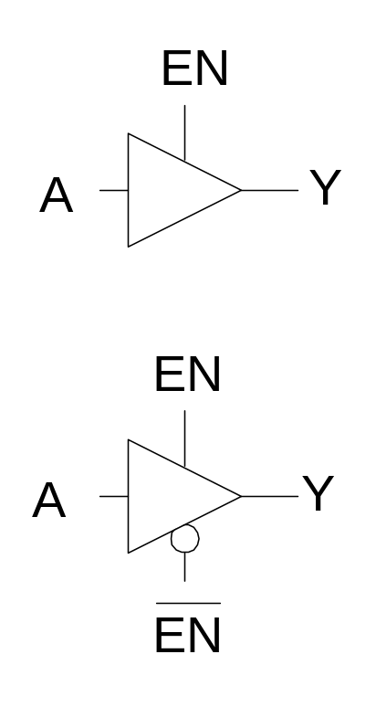
Tristates
Tristate buffer produces Z when not enabled
EN | A | Y
0 | 0
0 | 1
1 | 0
1 | 1

Slide 18
Tristates
Tristate buffer produces Z when not enabled
EN | A | Y
0 | 0 | Z
0 | 1 | Z
1 | 0 | 0
1 | 1 | 1

Slide 19
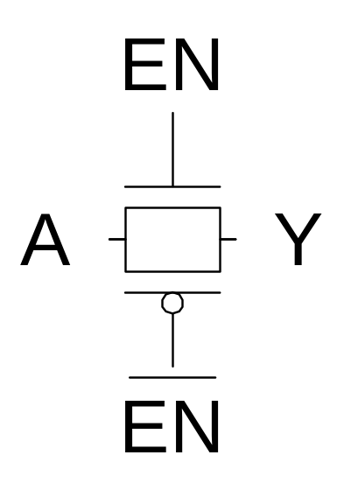
Nonrestoring Tristate
Transmission gate acts as tristate buffer
  Only two transistors
  But nonrestoring
    Noise on A is passed on to Y

Slide 20
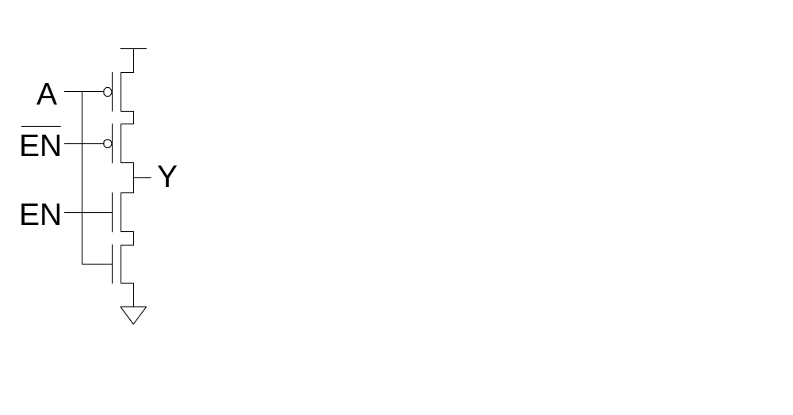
Tristate Inverter
Tristate inverter produces restored output
  Violates conduction complement rule
  Because we want a Z output

Slide 21
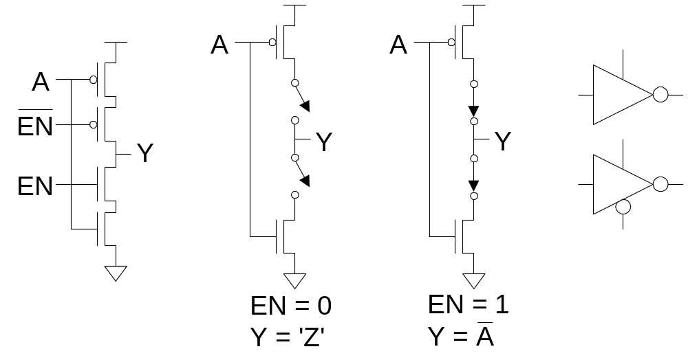
Tristate Inverter
Tristate inverter produces restored output
  Violates conduction complement rule
  Because we want a Z output

Slide 22
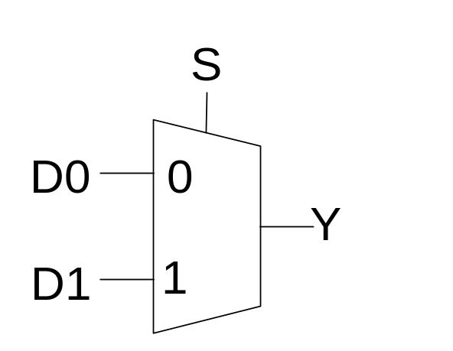
Multiplexers
2:1 multiplexer chooses between two inputs
S | D1 | D0 | Y
0 | X | 0
0 | X | 1
1 | 0 | X
1 | 1 | X

Slide 23
Multiplexers
2:1 multiplexer chooses between two inputs
S | D1 | D0 | Y
0 | X | 0 | 0
0 | X | 1 | 1
1 | 0 | X | 0
1 | 1 | X | 1

Slide 24
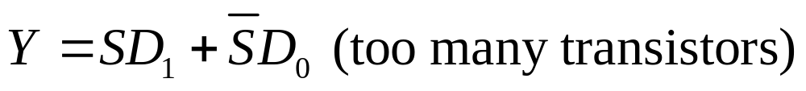
Gate-Level MUX Design
How many transistors are needed?

Slide 25
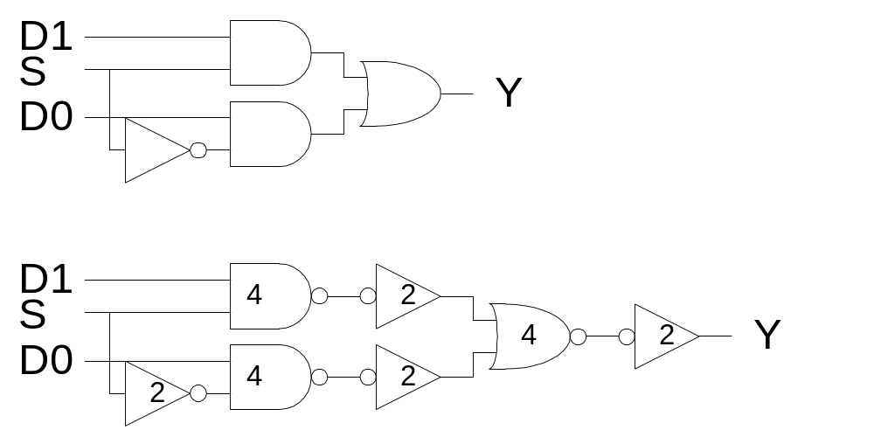
Gate-Level MUX Design
How many transistors are needed? 20

Slide 26
Transmission Gate MUX
Nonrestoring mux uses two transmission gates

Slide 27
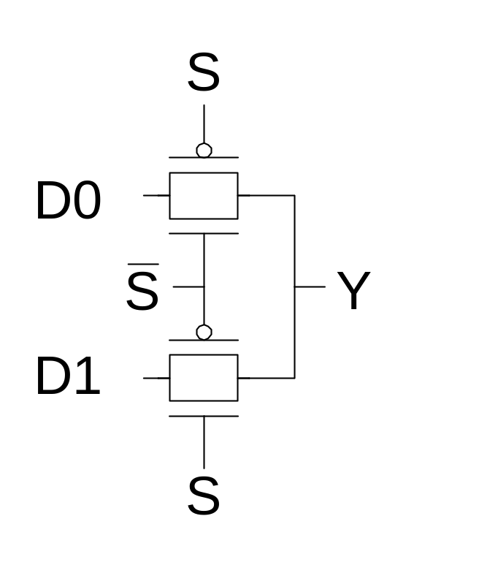
Transmission Gate MUX
Nonrestoring mux uses two transmission gates
  Only 4 transistors

Slide 28
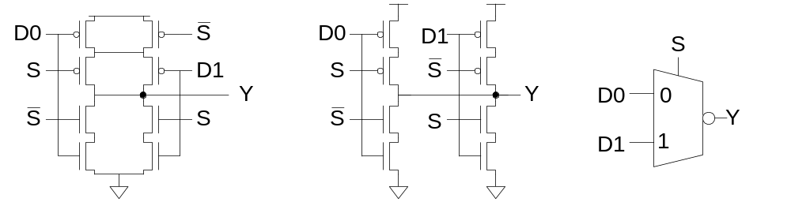
Inverting MUX
Inverting multiplexer
  Use compound AOI22
  Or pair of tristate inverters
  Essentially the same thing
Noninverting multiplexer adds an inverter

Slide 29
4:1 Multiplexer
4:1 MUX chooses one of 4 inputs using two selects

Slide 30
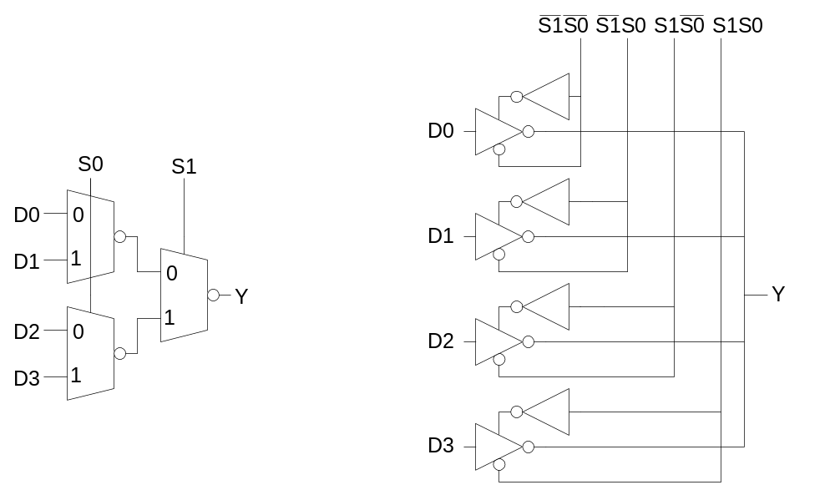
4:1 Multiplexer
4:1 MUX chooses one of 4 inputs using two selects
  Two levels of 2:1 MUXes
  Or four tristates

Slide 31
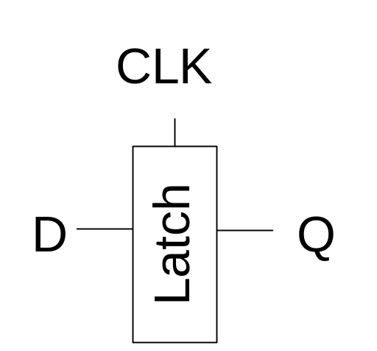
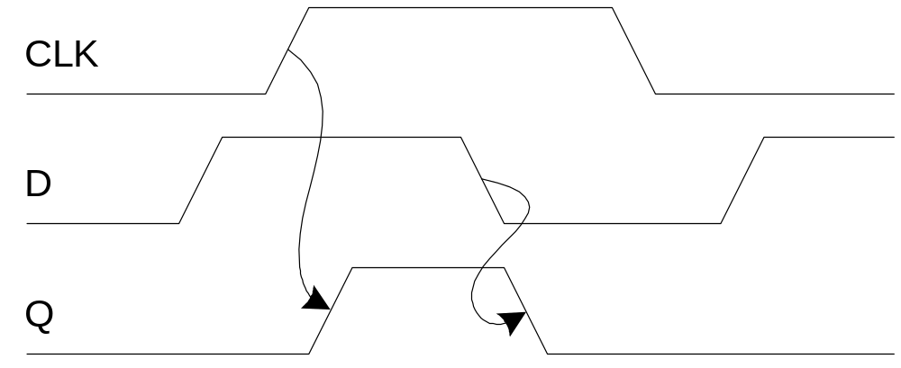
D Latch
When CLK = 1, latch is transparent
  D flows through to Q like a buffer
When CLK = 0, the latch is opaque
  Q holds its old value independent of D
a.k.a. transparent latch or level-sensitive latch

Slide 32
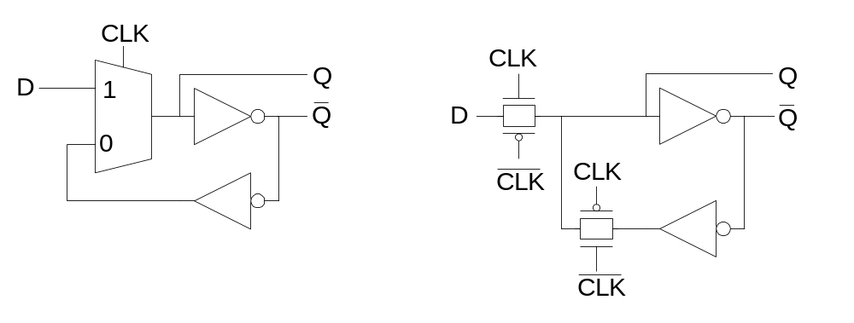
D Latch Design
Multiplexer chooses D or old Q

Slide 33
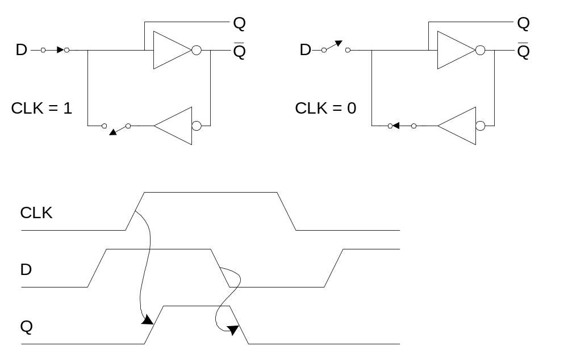
D Latch Operation

Slide 34
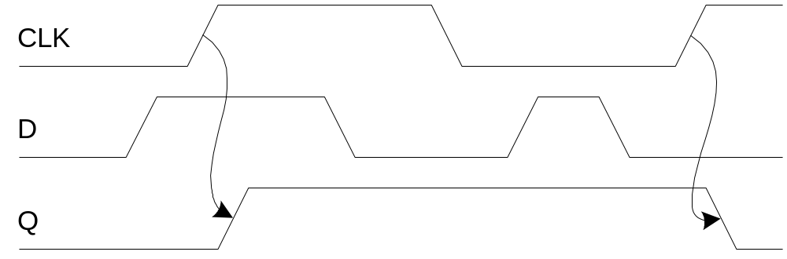
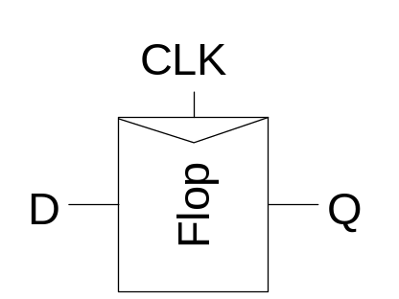
D Flip-flop
When CLK rises, D is copied to Q
At all other times, Q holds its value
a.k.a. positive edge-triggered flip-flop, master-slave flip-flop

Slide 35
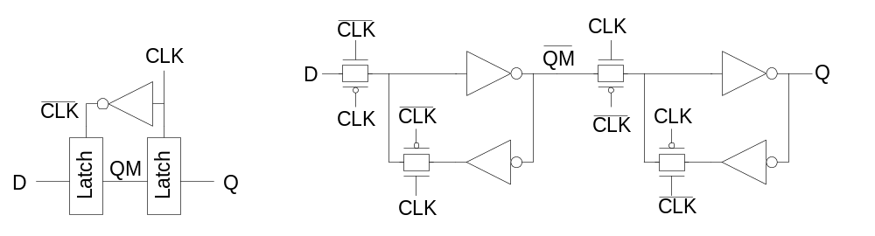
D Flip-flop Design
Built from master and slave D latches

Slide 36
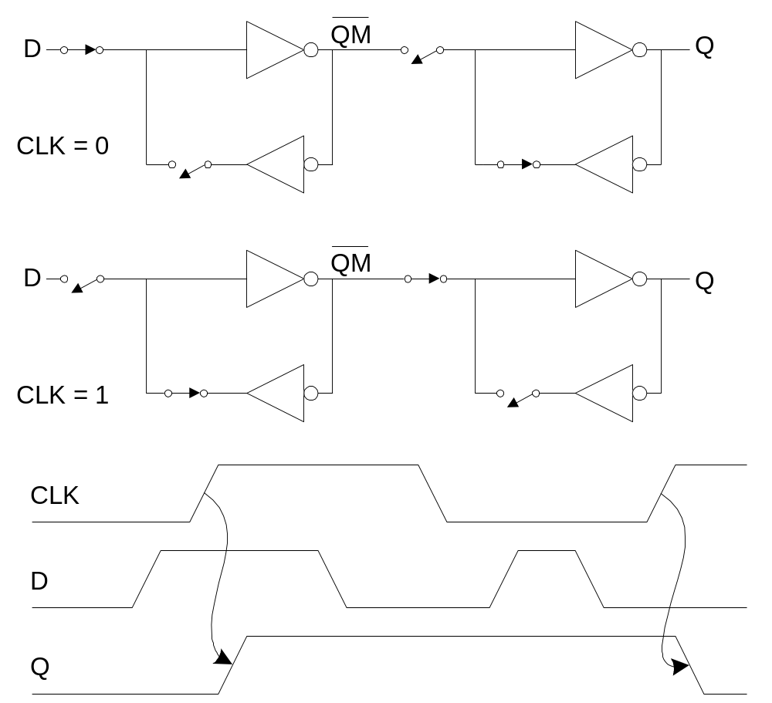
D Flip-flop Operation

Slide 37
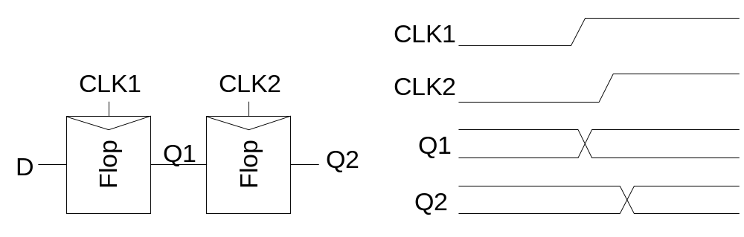
Race Condition
Back-to-back flops can malfunction from clock skew
  Second flip-flop fires late
  Sees first flip-flop change and captures its result
  Called hold-time failure or race condition

Slide 38
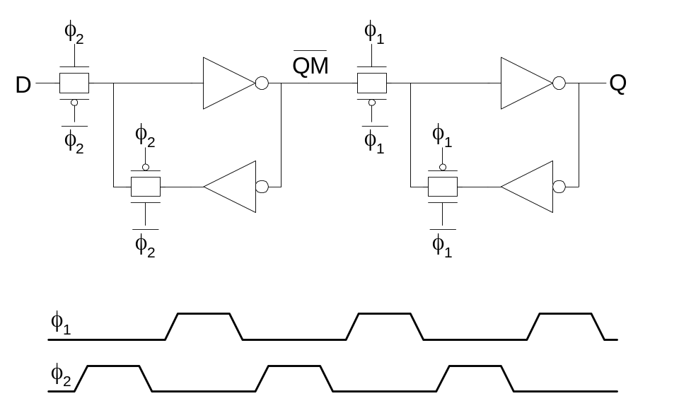
Nonoverlapping Clocks
Nonoverlapping clocks can prevent races
  As long as nonoverlap exceeds clock skew
We will use them in this class for safe design
  Industry manages skew more carefully instead

Slide 39
Gate Layout
Layout can be very time consuming
  Design gates to fit together nicely
  Build a library of standard cells
Standard cell design methodology
  V_{DD} and GND should abut (standard height)
  Adjacent gates should satisfy design rules
  nMOS at bottom and pMOS at top
  All gates include well and substrate contacts

Slide 40
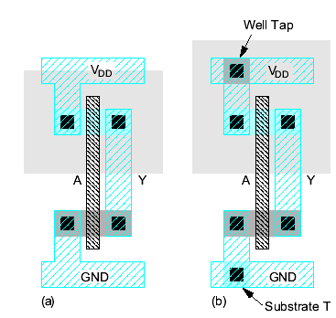
Example: Inverter

Slide 41
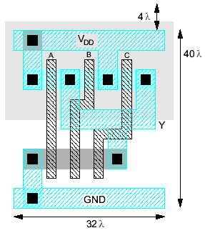
Example: NAND3
Horizontal N-diffusion and p-diffusion strips
Vertical polysilicon gates
Metal1 V_{DD} rail at top
Metal1 GND rail at bottom
32 λ by 40 λ

Slide 42
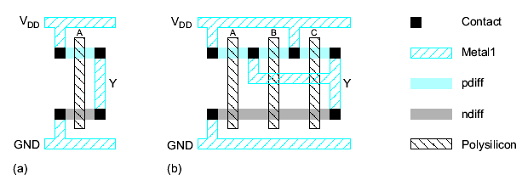
Stick Diagrams
Stick diagrams help plan layout quickly
  Need not be to scale
  Draw with color pencils or dry-erase markers

Slide 43
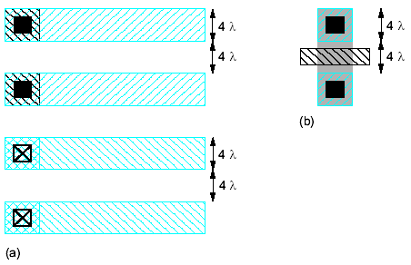
Wiring Tracks
A wiring track is the space required for a wire
  4 λ width, 4 λ spacing from neighbor = 8 λ pitch
Transistors also consume one wiring track

Slide 44
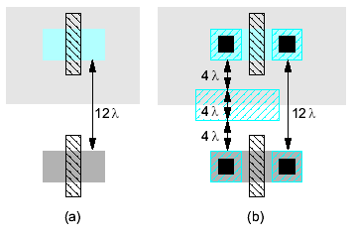
Well Spacing
Wells must surround transistors by 6 λ
  Implies 12 λ between opposite transistor flavors
  Leaves room for one wire track

Slide 45
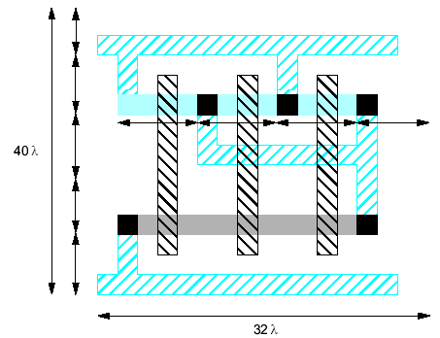
Area Estimation
Estimate area by counting wiring tracks
  Multiply by 8 to express in λ

Slide 46
Example: O3AI
Sketch a stick diagram for O3AI and estimate area
Y = ( A + B + C) D

Slide 47
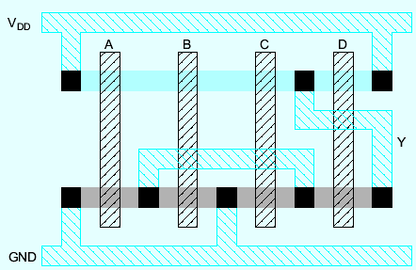
Example: O3AI
Sketch a stick diagram for O3AI and estimate area
Y = ( A + B + C) D

Slide 48
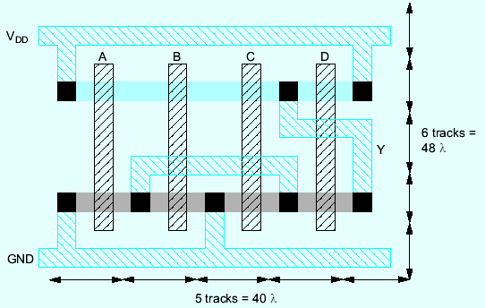
Example: O3AI
Sketch a stick diagram for O3AI and estimate area
Y = ( A + B + C) D
Y = (A + B + C) D

Slide 49
Sticks Diagrams
Sketch a stick diagram for a 4-input NOR gate

Slide 50
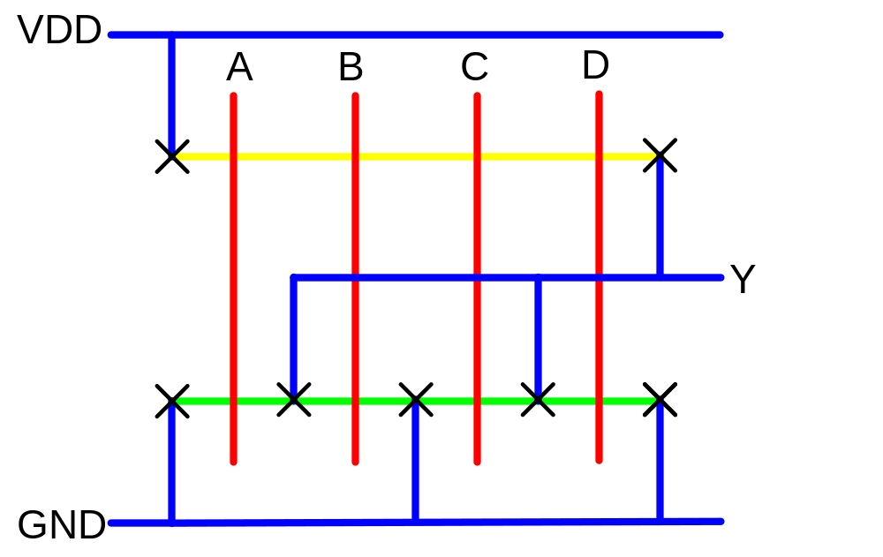
Sticks Diagrams
Sketch a stick diagram for a 4-input NOR gate

Slide 51
Conclusion
CMOS has displaced all of the other logic families
  Much less power consumption
  With aggressive transistor scaling, approaches the speed of the fastest traditional Bipolar logic families
  Massive transistor density compared with Bipolar
  Suitable for analog circuit implementation
All nFETs can share the same substrate
All pFETs can share the same substrate
May ultimately be displaced if leakage power problem is not solved

Slide 52
Summary
CMOS Logic Gate Design
Pass Transistors
CMOS Latches & Flip-Flops
Standard Cell Layouts
Stick Diagrams

